Slide 1
Assembler Directives
Pseudo-operations
do not refer to operations executed by program
used by assembler
look like instruction, but “opcode” starts with dot
Opcode | Operand | Meaning
.ORIG | address | starting address of program
.END |  | end of program
.BLKW | n | allocate n words of storage
.FILL | n | allocate one word, initialize with value n
.STRINGZ | n-character string | allocate n+1 locations, initialize w/characters and null terminator

Slide 2
LC-3 TRAP Routines(service routines)
GETC (TRAP x20)
Read a single character from KBD.
ASCII copied in R0, R0[15:8] cleared.
OUT (TRAP x21)
Write R0[7:0] to screen.
PUTS (TRAP x22)
Write a string to screen. String address in R0.
IN (TRAP x23)
Print a prompt on the screen and read a single character from KBD.
Character is echoed to Display. ASCII copied to R0[7:0] and R0[15:8] cleared.
HALT (TRAP x25)
Prints message on screen & halts execution.
x0000
:
:
x0020
x0400
x0021
x0430
x0022
x0450
x0023
x04A0
x0024
x04E0
x0025
xFD70
:
:
x00FF
The LC-3 System
Control Block

Slide 3
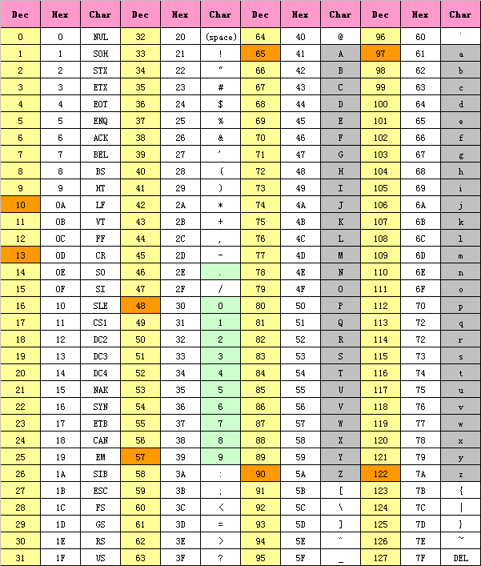
ASCII（American Standard Code for Information Interchange）

